Slide 1
Finance
04. Infinitives

Slide 2
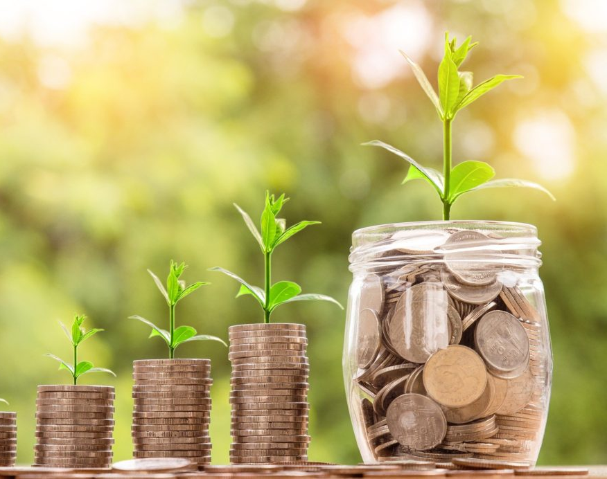
Finances
Do you save money?
What financial advice would you give to your younger self?
What are some bad money habits you could stop in order to save more for the future?
Payroll: salary
Withdraw: take money from your bank account
Ant expenses: small expenses on unnnecesary things

Slide 3
Infinitives
An infinitive is the "to" form of the verb. You can also use an infinitive as the subject, the complement, or the object of a sentence.
To learn is important. subject of sentence
The most important thing is to learn. complement of sentence
He wants to learn. object of sentence
Infinitives can be made negative by adding "not."
I decided not to go.
The most important thing is not to give up.
Infinitives can be used after agree, ask, decide, manage, refuse, want, among other.
Notes:
What do want to do after class?
What did you decide not to do?

Slide 4
When do we use infinitives?
After adjectives: This chair is unconfortable to sit on.
To give a reason: I drink water to hidrate.
After these verbs:
agree | deserve | fail | manage | offer | vow | wait
appear | demand | get | learn | plan | tend | yearn
arrange | decide | happen | intend | pretend | swear | threaten
care | claim | hesitate | hope | refuse | seem | want

Slide 5
Fill in the blank
It is important ______ calm in stressful situations.
She was happy ______ an award.
I am eager ______ new languages
The movie was too scary ______ alone.
He is kind enough ______ anyone in need.
______ in life, one must work hard.
The weather is perfect ______ for a walk.
It was very generous ______ her time and money to the cause.
You should practice regularly ______ your writing skills.
She decided ______ her job to pursue her passion.
to go
to succeed
to receive
to stay
to learn
to donate
to watch
to help
to quit
to improve
Notes:
It is important to stay calm in stressful situations.
She was happy to receive an award.
I am eager to learn new languages
The movie was too scary to watch alone.
He is kind enough to help anyone in need.
To succeed in life, one must work hard.
The weather is perfect to go for a walk.
It was very generous to donate her time and money to the cause.
You should practice regularly to improve your writing skills.
She decided to quit her job to pursue her passion.

Slide 6
Infinitives, would like/love/hate
The expressions would like, would love, and would hate are also followed by an infinitive.
Would you like to save more?
I would love to organize my expenses.
I would hate to lose money.
Notes:
What would you hate to do?
What would like/love/hate to do on weekends?

Slide 7
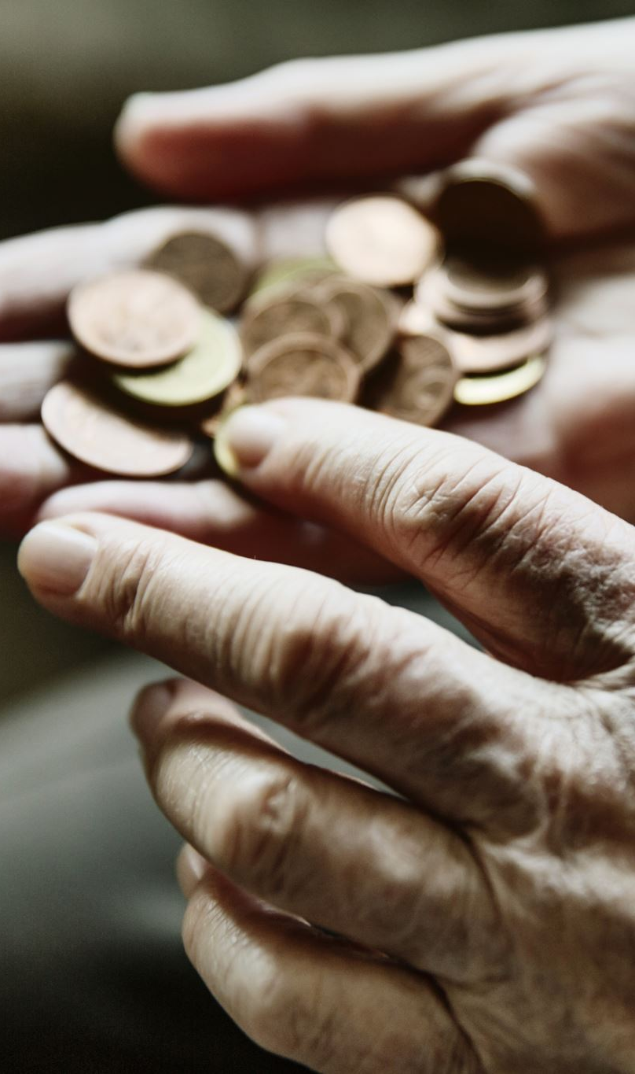
Complete the sentences
Putting aside money is a priority for us right now. We need ______ (keep track of) our expenses.
It’s not that difficult ______(live) within your means. If you can’t afford ______ (buy) something, don’t buy it!
The bank manager explained the importance of paying our credit card balance on time. This is the best way ______ (avoid) fines.
If you come into money, I advise you ______ (invest) it instead of going on a spending spree.
In my opinion, having a lot of money doesn’t make you immoral. Money can be a positive thing if you decide ______ (put) it to good use.
How do you expect ______ (cut down on) your expenses if you keep overspending?
It’s not worth exploiting workers just ______ (boost) profits. Companies should refuse ______ (pay) them such low wages.
Supermarkets encourage people ______ (buy) products by offering them special deals.
Some people believe they deserve ______ (receive) an award for not spending money.
If you happen ______ (inherit) some money, do not spend it all.
Notes:
to keep track of
to live; to buy
3. To avoid
4. to invest
5. To put
6. to cut down on
7. To boost, to pay
8. to buy
9. to receive
10. to inherit

Slide 8
Financial advice
Discuss with your classmates the following questions:
When you buy something, do you always buy insurance for it?
What are some effective ways to save money in our day to day lives?
Some people say you need money to make money. What do you think it means and do you agree or disagree?
When you are in a relationship or married, you have to think about your partner’s financial situation. Do you openly talk about it?
Notes:
Community property: a U.S. state-level legal distinction that designates a married individual's assets. Any income and any real or personal property acquired by either spouse during a marriage are considered community property and thus belong to both partners of the marriage. Bienes mancomunados.

